Slide 1
Entrepreneurship BS-CS – 2022 – Spring Semester
Salmaan Rahman
Lecture 8
Legal and Management Issues
Intellectual Property

Slide 2
What type of Business?
Three basic types:
(Sole) Proprietorship
Partnership
General
Limited
Corporation
Choice of business type depends on issues such as
Ownership, taxation, liability, start-up costs, continuity, transferability, capital requirements, management control, profit distribution, capital raising.

Slide 3
 | Proprietorship | Partnership | Corporation
Ownership | Individual | No limit on number of partners | No limit on number of stock-holders
Start-up costs | Very little – filing fees | Legal costs: filing, partnership agreement, trade name. | Legal articles of incorporation, filing fees, taxes, national and local.
Liability | Individual liable for business liabilities | General: all partners liable Limited: limited to amount of capital contribution. | Amount of capital contribution.
Continuity | Dissolved by death | General: Death of partner terminates partnership unless prior agreement Limited: no effect. Limited partner can withdraw capital after notice | Death or withdrawal of owners has no effect on continuity

Slide 4
 | Proprietorship | Partnership | Corporation
Transferability | Complete freedom to sell or transfer any part of business | General: can sell or transfer only with partner consent Limited: can sell without consent | Most flexible – can sell stocks at any time. (some stocks might be restricted)
Capital Requirements | Capital raised through loan or personal investment | Loans or new investments require change in agreement | Capital raised by sale of stocks or bonds or borrowing in name of corporation
Management Control | Owner takes all decisions and can act immediately | All partners have equal control and vote by majority. Limited: Only general partners have authority to take decisions. | Majority stockholders have most control. Daily control is in the hands of management who may not be stockowners.

Slide 5
 | Proprietorship | Partnership | Corporation
Profit / loss distribution | Owner receives all profits and incurs all losses | Depends on partnership agreement and investment ratios | Shareholders given dividends. (at manager discretion)
Capital raising | Depends on owner skills with finding capital | Depends on partner’s capabilities and success of business | Attractive for both banks and venture capitals as investment opportunity.
Tax benefits | Single, personal taxation | Each partner pays taxes on share of profits (personal taxes) | Double taxation.

Slide 6
Founder’s agreement
Essential whenever two or more people start a business
A written document that deals with typical issues
Split of equity
Decision making
Profit sharing
Buyback clauses
Liquidation issues

Slide 7
Founder’s agreement Things to include:
nature of the prospective business
Identity and proposed titles of the founders
Legal form of business ownership
Consideration paid for stock or ownership share of each of the founders (may be cash or “sweat equity”)
Identification of any intellectual property signed over to the business by any of the founders
Description of how the founders will be compensated and how the profits of the business will be divided
Basic description of how the business will be operated and who will be responsible for what
Description of the outside business activities that the founders will not be allowed to engage in (e.g., you wouldn’t want a founder to engage in an outside business that directly competed with your business)
Provisions for resolving disputes (many founders’ agreements include a stipulation that disputes will be resolved via mediation or arbitration rather than through the courts)
Buyback clause, which explains how a founder’s shares will be disposed of if she or he dies, wants to sell, or is forced to sell by court order

Slide 8
Registering a business
ALWAYS REGISTER YOUR BUSINESS!
Legal protections
Trademark/Patent issues
Non-compete, non-disclosure clauses
Business licenses and Permits
Federal/Provincial Licenses and Permits

Slide 9
Corporations
Generally more difficult to establish
“Articles of incorporation” need to be filed with relevant business department.
Name
Purpose/nature of business
Number of shares, classes of shares
Limited Liability Company
Hybrid between corporation and partnership
Liability is limited and taxes are single
Shareholders are called “members” and their shares are labeled “interest”
Cannot be publically traded

Slide 10
Organization design
Simpler always works better for start-ups!
Often the entrepreneur wears all the hats.
Also often the cause of failure!
As business increases in size, or partnership, roles have to be allocated.
Defining roles and formalizing positions help personnel understand what is expected of them.

Slide 11
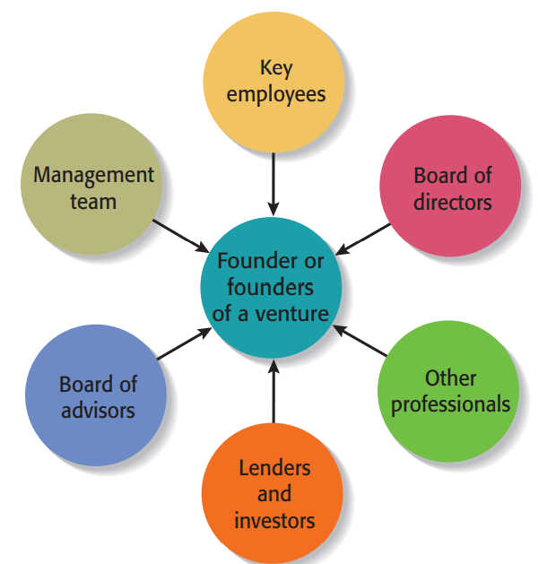
New venture team

Slide 12
New venture teams Common mistakes
Placing unqualified friends or family members in management positions
Assuming that previous success in other industries automatically translates to your industry
Presenting a “one person team” philosophy—meaning that one person (or a small group of people) is wearing all hats with no plans to bolster the team
Hiring top managers without sharing ownership in the firm
Not disclosing or talking dismissively of management team skill or competency gaps
Vague or unclear plans for filling the skill or competency gaps that clearly exist.

Slide 13
Hiring Qualified People for start-up team
Workers are hired though a interview process
Identify the exact skills and competences needed for the job
Prepare a job description
Advertize job/find worker
Newspaper, online (Linkdin), network
Interview process
Competency based hiring vs. Qualification based hiring
Qualification assessment and verification (resumes)
Competence demonstration – interview, skill testing
Arrive at compensation agreement

Slide 14
Compensation methods
Salary
Hourly
Weekly
Monthly
Commissions – based on pre-agreed goals
Per project/contract
Benefits
Car, house, vacation time, retirement accounts etc
Firm investment/ownership
Shares, bonuses tied to performance

Slide 15
Intellectual Property

Slide 16
Intellectual Property
Intellectual Property: knowledge, information and ideas that belong to a firm
Intellectual property often represents a start-up firm’s most valuable asset
Name of firms
Facebook, Google trademarks
Logos
Apple design
Intellectual property always needs to be protected – it has market value and can be sold and licensed
It also has costs.

Slide 17
Intellectual Property
Intellectual property is any product of human intellect that is intangible but has value in the marketplace.
It is called “intellectual” property because it is the product of human imagination, creativity, and inventiveness.
Traditionally, businesses think of physical assets such as land, buildings, and equipment as most important assets. Increasingly, however, a company’s intellectual assets are the most valuable

Slide 18
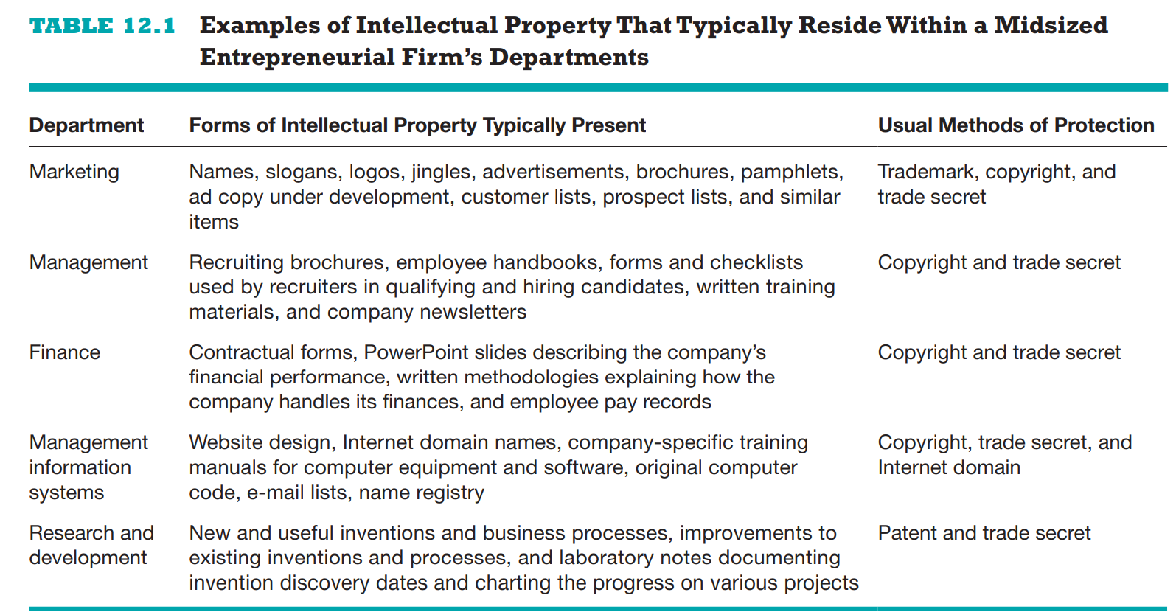

Slide 19
Legal Protections
Determine which intellectual property to protect
Directly related to competitive advantage
Amazon “One-click”
Website (name, logo, address)
Has value in market place
Not all logos have value!
Anything that is new, invented – consider its value

Slide 20
Forms of Intellectual Property
Patents
A grant from the government conferring the rights to exclude others from making, selling, or using an invention for the term of the patent
Trademarks
Any word, name, symbol, or device used to identify the source or origin of products or services and to distinguish those products or services from others.
Copyrights
A copyright is a form of intellectual property protection that grants to the owner of a work of authorship the legal right to determine how the work is used and to obtain the economic benefits from the work.
Trade Secrets
Any formula, pattern, physical device, idea, process, or other information that provides the owner of the information with a competitive advantage in the marketplace

Slide 21
Patents
Caveat: a patent does not give the inventor the right to sell – only to prevent others from doing so
Patents which incorporate other patents need permission – most new inventions are improvements on older methods
Patents are usually time limited
Types:
Utility patents
Most common
Business Method Patent
Design Patents
Plant Patents

Slide 22
Patents - Types
Utility patents (20 years)
Most common
Granted to anyone who “invents or discovers any new and useful process, machine, manufacture, or composition of matter, or any new and useful improvement thereof.”
E.g new drugs
Requires: A complete description of the invention, including drawings and technical details
Patent must be applied for within one year of when a product or process was first offered for sale, put into public use, or was described in any printed publication
Business Method Patent
Protects an invention that facilitates a method of doing business
Methods, mathematical algorithms, software
Amazon One-Click, Priceline – “Name your price”, Netflix – queue method.

Slide 23
Patents - Types
Design Patents (14 years)
While a utility patent protects the way an invention is used and works, a design patent protects the way it looks.
E.g if you invent a new version of the computer mouse, apply for a utility patent to cover the way the mouse works and for a design patent to protect the way the mouse looks as long as each new design is considered by the USPTO to be novel and non-obvious
product design is an important source of competitive advantage
Plant Patents (20 years)
Agricultural

Slide 24
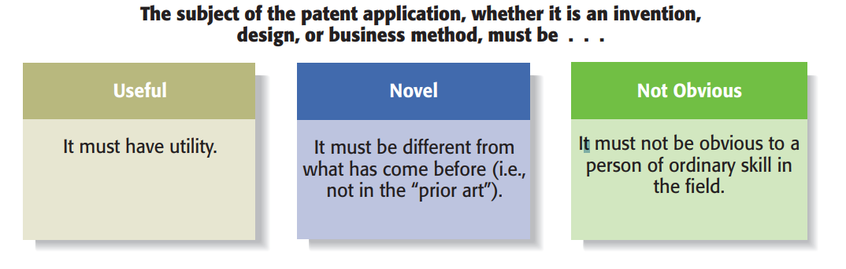
Patent Requirements

Slide 25
Patent Applications
Pakistan: https://ipo.gov.pk/patent
International : https://www.wipo.int/pct/en/
(protection. Not a legal status)
USA: https://www.uspto.gov/

Slide 26
Trademarks
A trademark is any word, name, symbol, or device used to identify the source or origin of products or services and to distinguish those products or services from others.
All businesses want to be recognized by their potential clientele and use their names, logos, and other distinguishing features to enhance their visibility.
Trademarks provide consumers with useful information and what to expect.

Slide 27
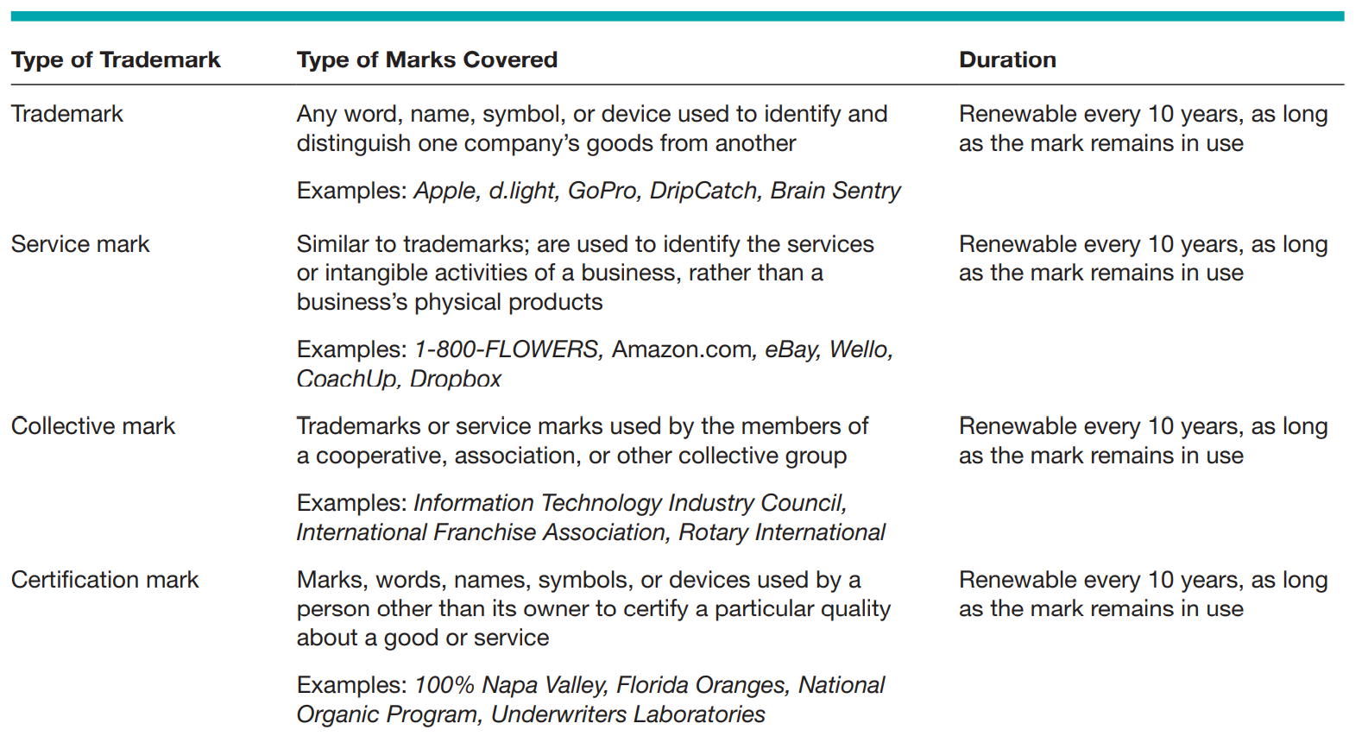

Slide 28
Trademarks – What is protected
Words: All combinations of words - single words, short phrases, and slogans.
E.g: Birchbox, Warby Parker, and the National Football League
Numbers and letters: e.g. 3M, Boeing 787, and AT&T.
Designs or logos: A mark consisting solely of a design e.g. Cisco Systems, Nike swoosh logo
mark must be distinctive rather than generic
Sounds: Distinctive sounds - e.g. MGM’s lion’s roar, AOL “You’ve got mail!” Samsung tone
Fragrances
Shapes: e.g. Apple iPod, Coca-Cola Company curved bottle
Colors: e.g. Nexium, a medicine pill that treats acid reflux disease, is purple and is marketed as “the purple pill.” The color of the pill has no bearing on its functionality; therefore, it can be protected by trademark protection
Trade dress: The manner in which a product is “dressed up” to appeal to customers is protectable. This category includes the overall packaging, design, and configuration of a product. As a result, the overall look of a business is protected as its trade dress

Slide 29
Copyrights:
Copyright - a form of intellectual property protection that grants to the owner of a work of authorship the legal right to determine how the work is used and to obtain the economic benefits from the work
The work must be in a tangible form, such as a book, operating manual, magazine article, musical score, computer software program, or architectural drawing
Businesses typically possess a lot copyrightable material
A work does not have to have artistic merit to be eligible for copyright protection - operating manuals, advertising brochures, and training videos qualify for protection.
original work is protected automatically from the time it is created and put into a tangible form, whether it is published or not

Slide 30
Copyrights: What is protected
Literary works: Anything written down is a literary work.
Books, poetry, reference works, speeches, advertising copy, employee manuals, games, and computer programs.
Characters found in literary works e.g. Garfield, the cartoon cat
Musical compositions:
Any musical composition, including any accompanying words, that is in a fixed form e.g. musical score, CD, or MP3 file
Owner of the copyright is usually the composer and possibly a lyricist.
Derivative works (unique updates of older copyrights are also copyrightable as long as permission is granted from orginator
Computer software: since 1980,
All forms of computer programs are protected.
Dramatic works: - eg. play, comedy routine, newscast, movie, or television show
Pictorial, graphic, and sculptural works
photographs, prints, art reproductions, cartoons, maps, globes, jewelry, fabrics, games, technical drawings, diagrams, posters, toys, sculptures, and charts

Slide 31
Trade Secrets:
Trade secret - any formula, pattern, physical device, idea, process, or other information that provides the owner of the information with a competitive advantage in the marketplace
marketing plans, product formulas, financial forecasts, employee rosters, logs of sales calls, laboratory notes
Eg. KFC chicken recipe
Characteristics:
Is not known outside the company
Is known only inside the company on a “need-to-know” basis
Is safeguarded by stringent efforts to keep the information confidential
Is valuable and provides the company a compelling competitive advantage
Was developed at great cost, time, and effort
Cannot be easily duplicated, reverse engineered, or discovered

